Slide 1

CaseAI
ASHOK Vinayak
SCAGLIONE Pietro
SHARMA Neha
SHAYDULLIN Kamil
ZHANG Julia
March, 2024
Notes:
Welcome to Case AI GenAI Case prep assistant.

Slide 2
The consulting recruitment process has become very competitive, and solid case preparation is more important than ever before
700k
Management Consulting Firms
$1201 billion
Projected Industry Size by 2025
1%
Acceptance Rate
Fragmented Resources
There are several websites, forums, blogs, videos and case books offering advice and practice materials. But not a one-stop interactive shop which curates a case catered to the company you are preparing for. A lot of time is wasted on synthesizing information from several platforms with varied content in quality.
Unstructured Preparation Plans
Lack of personalized preparation plans tailored to user’s strengths, weaknesses, and learning preferences, ensuring a focused approach
Interactive Learning
Currently, we need to schedule sessions with experts or peers to prepare for case interviews. There are no solutions available to practice cases anytime, anywhere adding to the lack of flexibility during already stressful times.
Notes:
What is our market? We are surrounded by 700,000 management consulting firms, with a projected industry size of $1200 billion dollar by 2025. ----------------------------------------- What is the problem we are solving? If you thought networking, writing cover letters and getting the first round of consulting interviews was half the battle won, sorry to burst your bubble, the journey has just begun.
As if navigating plethora of resources like VictorCheng, CaseCoach, wasn’t enough. We also have to schedule time with peers for practice and create a plan based on strengths and our weakness. If only we had one-stop shop for all our consulting problems.

Slide 3

CaseAI can help students take the first step in their consulting case preparation efforts
Expert-Crafted Scenarios
AI-Driven Feedback
Centralized Case Resources
Precise Timekeeping Features
Personalized Learning Path
Multi-Platform Accessibility
On-Demand Interactive Learning
Voice-Enabled Interaction
Notes:
Fret now, we at CaseAI are here to make your life better.
CaseAI not only uses the fine-tuned model for crafting new cases but also takes into account your previous progress, areas you lack, and specific industries and regions you are targetting.
For all those folks targetting ME, consulting needs, we have you covered for your specific needs.

Slide 4



Our product targets both individual users and corporate entities
B2C
B2B
Students & Professionals
Wants to enter or pivot into consulting industry
Preps for case interviews with partners for effective practice and feedback
Business Schools
Wants to elevate students' success rates and reinforce reputation as premier educational institutions
Consulting Firms
Looks for innovative tools to replace resource-intensive case workshops and de-bias interview process
“The hardest part about preparing for consulting interviews is finding a great case partner who can give me valuable feedback. Also, it’s hard to find someone who is willing to invest time to case with me…” – INSEAD student
“We know that many of our students want to break into the consulting industry. There are a lot of resources available but still we see gaps in ways to help our students land their dream job.” – Career coach at business school
Notes:
Our product appeals to two types of customers: B2C and B2B
For B2C, our target customer groups are students and professionals who want to enter or pivot into consulting and are preparing for case interviews
For B2B segment, we want to target business schools such as INSEAD which want to elevate students' success rates at getting into consulting and thus reinforce their reputation as premier educational institutions
Our product will also appeal to consulting firms who are looking for innovative tools to replace resource intensive case workshops and streamline and also de-bias interview processes. We envision our product to someday replace human interviewers who can spend their time on more value-adding tasks, such as on billable client projects

Slide 5
Our product could serve the needs of at least 40K annual MBB candidates worldwide
Users’ Funnel
Methodology
The top three strategy consulting firms (i.e., McKinsey, BCG, Bain, frequently known as MBBs) have a total of 85k employees worldwide¹, of which:
23k work as Engagement Managers (EMs), Associate Partners (APs) and Partners²
30k work as supporting staff³ (e.g., secretaries, knowledge analysts)
32k work as Analysts and Associates
Assuming that only 1% of the candidates applying is enrolled as Analyst or Associate, 3.2M candidates apply to such roles for MBBs annually
3.2 M
A conservative factor of 33% is applied to the perimeter in scope to account for potential double counting. More specifically, it was assumed that a person that receives an offer from one of the MBBs has also applied to the remaining two, leading to a perimeter of 1.05M yearly applicants
1.05M
Out of the 1.05M applicants identified, 200k are assumed to rely on on-line platforms based on the following data:
CaseCoach, one of the most reliable interview preparation platforms in the market, has 60k yearly users¹
Such market is mainly dominated by five other on-line platforms⁴ (e.g., PrepLounge, CaseInterview), whose number of yearly users has been assumed based on how many monthly visitors each platform registers
200K
Given the competitiveness, the effectiveness and the accessibility of the tool, we assume a penetration rate equal to 20%, leading to an estimated perimeter of 40k annual users
40K
1. Source: Companies websites | 2. The number of Partners and APs has been estimated based on public McKinsey figures (i.e., ~13% of the entire staff), the number of EMs has been assumed to be ~13% of the entire staff (i.e., twice as many as the APs/Partners, based on internal data) | 3. Source: internal data | 4. Source: https://www.similarweb.com/website/preplounge.com/competitors/

Slide 6
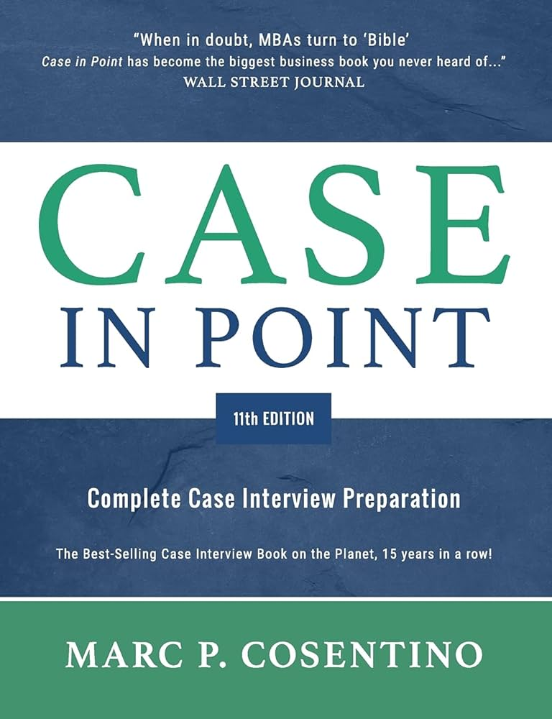




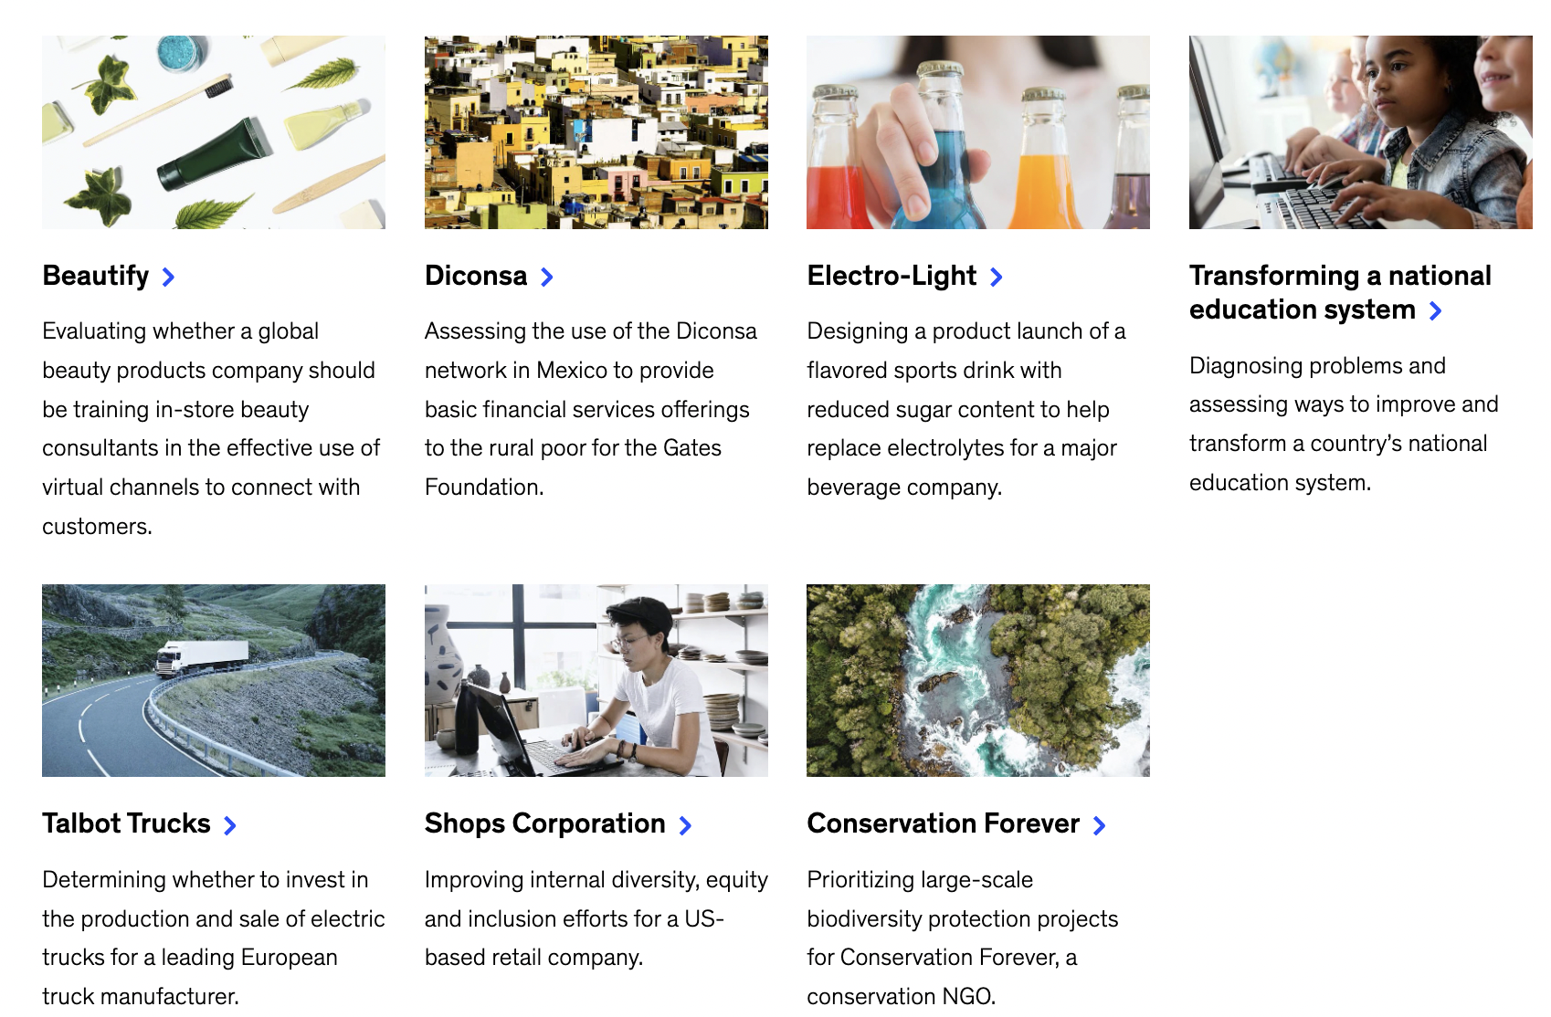
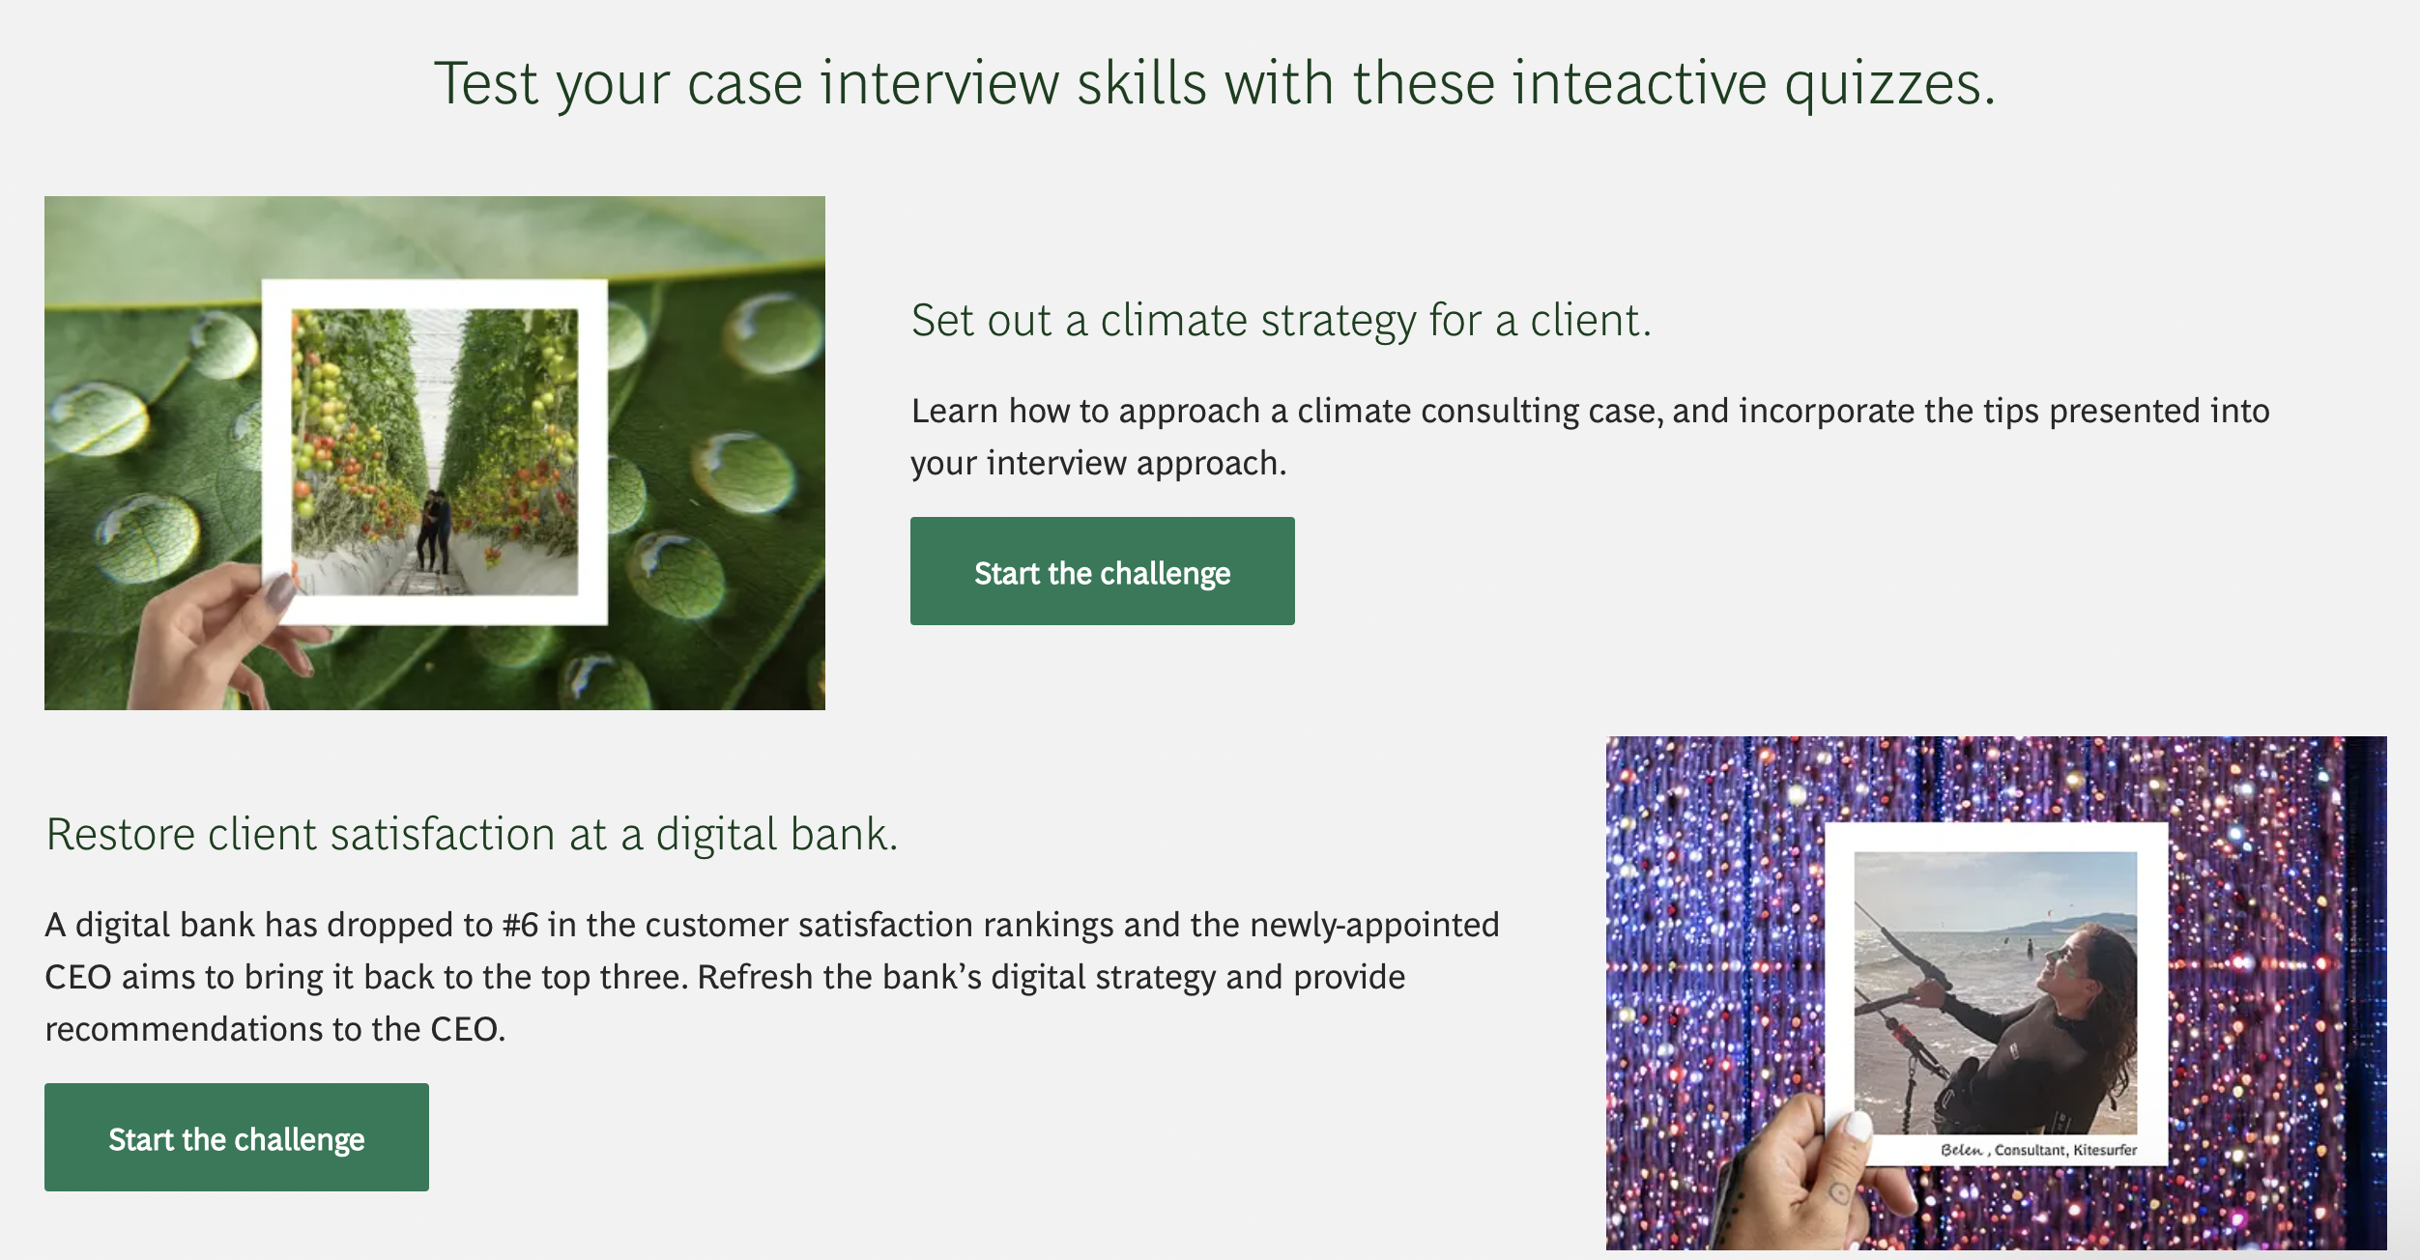
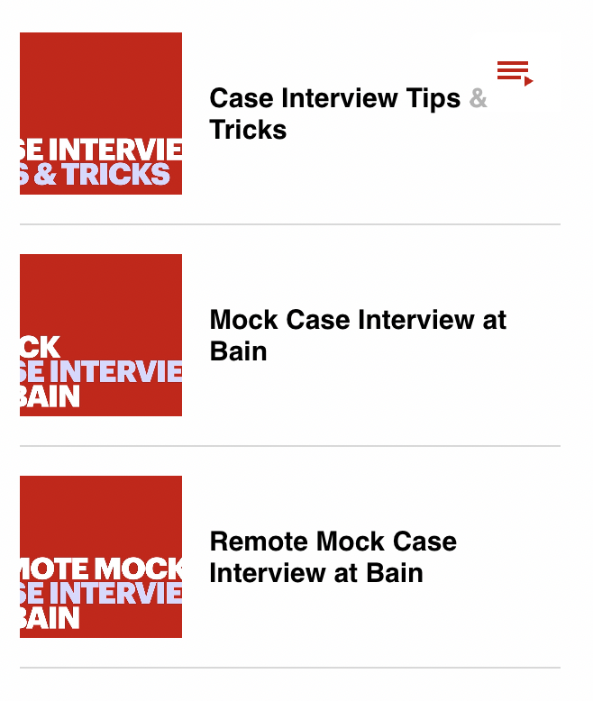










The consulting case resources spans across many formats, but none of them leverage genAI
1. Case Interview Books
3. Consulting Firm Websites and Resources
2. Online Platforms
4. Consulting Clubs at Universities

Slide 7
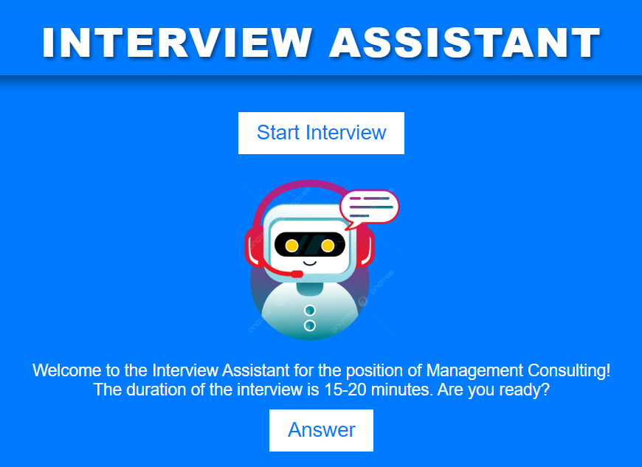



CaseAI MVP will be launched internally at INSEAD and will allow us to test and refine our product
CaseAI
CaseAI is an AI Assistant that will let users practice case interviews via an interface. Cases will consist of a prompt stating the business problem, 3/4 qualitative and quantitative questions and a recommendation. Users will be able to communicate with the chatbot by voice and receive feedback on how well they did with suggested areas of improvement.
Features
Finetuning Finetuning using a library of cases will ensure the model is effective at interviewing and evaluating of answers
Hardcoded timer The timekeeping feature will ensure the process of ideation and delivery is in line with the real interview process
Speech to text Speech recognition will let candidates practice delivery of their ideas by voice, like in a real interview
Notes:
Implemented in the form of a chatbot

Slide 8
Our simple technology stack ensures reliability
Front end - Chatbot interface created using HTML-CSS-Javascript
Back end – MVP is run using python programming language and flask framework, with an OpenAI agent generating textual data
Chatbot user interface
Python application
OpenAI agent
Python application
Chatbot user interface
User’s answers are recorded in audio format using the PyAudio library
Recorded audio file is transcribed using OpenAI’s Whisper model and sent to a specific OpenAI agent
Finetuned and RAG supported OpenAI agent analyzes a user’s answers and generates responses
Generated responses are retrieved by the python application and sent to the chatbot user interface
OpenAI agent’s responses are displayed in the user interface and read out by a text-to-speech model

Slide 9
CaseAI will cover all aspects of a typical consulting case from the prompt to the final recommendation
Registration and Subscription
Specification of case type
Prompt and clarifying questions
3/4 Questions to solve
Recommendation and Evaluation
User accesses the product via a website, registers and subscribes to services
To start practicing a user has to specify using drop-down menus the case difficulty, case type, industry/practice area
Once the practice case begins the chatbot reads out the case prompt and the user gets some time to ask clarifying questions about the business problem
Once the time is up the user is asked 3/4 structuring, quantitative and qualitative questions one by one which he has to answer to progress
Finally, the user is asked to provide a recommendation based on previous analysis. Then the chatbot evaluates the user’s performance and recommends areas for improvement

Slide 10


We anticipate several challenges that need to be addressed to be make the product successful
Potential Technical Challenges
Convenient interface We need to ensure the chatbot is as convenient for candidates as possible, so we need to create an interface via which candidates can access our chatbot. We aim to implement an interface similar to that of ChatGPT.
Evaluation of candidate performance To improve their case interview skills, candidates need to understand what went well during practice and what needs to be improved. Therefore, we need to ensure the model understands the nature of case interviews, is effective at interviewing, and can evaluate candidates’ quantitative and qualitative answers.
Accuracy in calculations Currently, LLMs are not always accurate at calculations because their approach to generating answers to queries is based on probability, not on actual understanding of the rules of math. Since we will base our chatbot on an LLM, we need to ensure it can produce correct answers to math problems without fail.

Slide 11
Over the next 12 months, we will refine the product and onboard the first customers
6-12 months
3-6 months
Expand customer base
0-3 months
Onboard INSEAD
Target other prestigious universities and business schools for expansion
Engage with consulting companies to explore partnership opportunities
Customize the product to cater to the specific needs of different institutions and industries
Establish a robust support and training system to ensure smooth onboarding for new customers
Implement scalable infrastructure to accommodate a growing user base
Test & Refine Product
Collaborate with INSEAD to onboard them as the inaugural customer
Utilize their diverse student body to gain valuable insights and feedback
Establish a strong partnership to showcase the effectiveness of the AI-backed case coach
Provide access to students for user feedback and data gathering
Continuously test and refine the product
Enhance features:
Improve calculations and visualization with advanced graphs
Introduce capability to generate new cases dynamically
Fine-tune feedback mechanisms and scoring algorithms
Notes:
This is the roadmap for the next 12 months
In phase 1 we will test and refine the product by providing access to our tool to students who want to pivot into consulting and preparing for case interviews
Based on their feedback, we will refine the product and enhance features, such as improving calculations, introducing capability to generate new cases dynamically, and fintune feedback and scoring mechanisms
In Phase 2, we will onboard our first customer, INSEAD, leveraging their diverse student body to gain valuable insights and more feedback
In phase 3, we will expand out customer base beyond INSEAD, targeting other universities and business schools and consulting companies

Slide 12




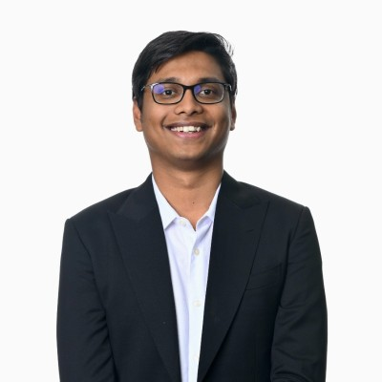

We have a founding team in place with diverse skillsets, complemented by senior advisors
Founding Team
Additional Team Members
Data Scientists/ Machine Learning Engineers
Product Managers
User Experience (UX) Designers
Business Development/ Sales
Legal and Compliance Experts
Kamil Shaydullin
CEO
Rafail Balis
Chief AI Officer
Neha Sharma
CPO
Pietro Scaglione
CRO
Vinayak Ashok
CFO
Julia Zhang
COO
Notes:
This is our founding team with backgrounds in tech, engineering, risk and consulting
To get the business to take off and reach its full potential, we need a multidisciplinary team with expertise in various domains, such as

